Slide 1
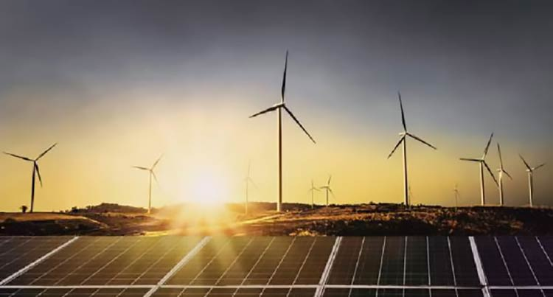

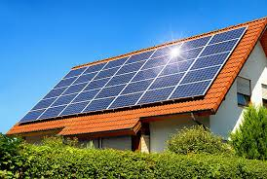
Energy Resources Belong to the People
Let us Stake our Claim Now
Eng Parakrama Jayasinghe

Slide 2
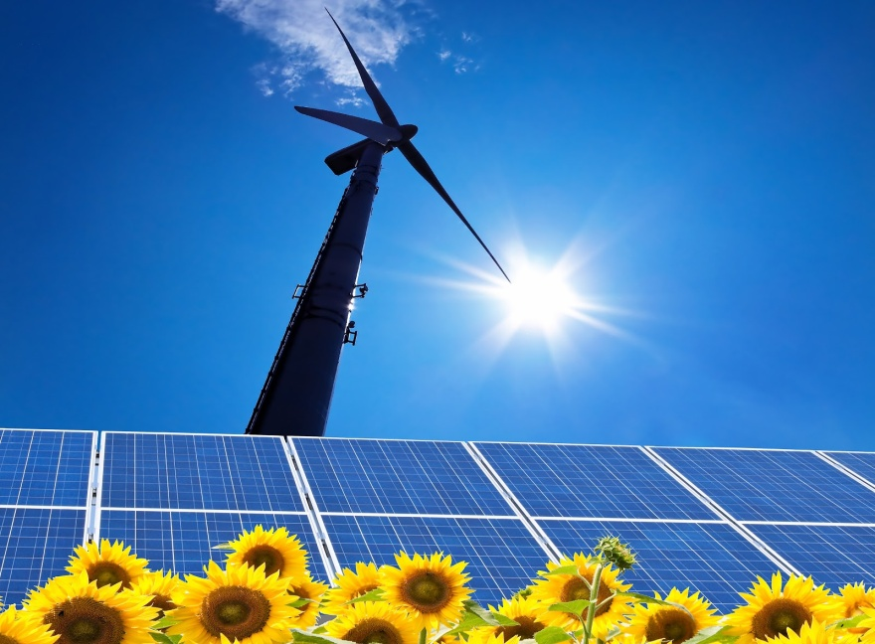
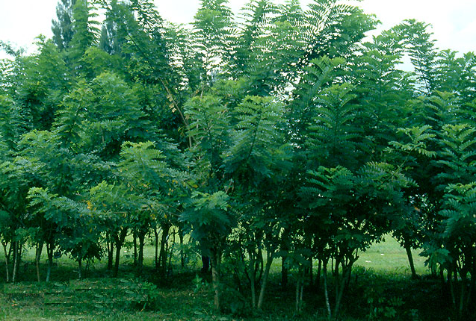
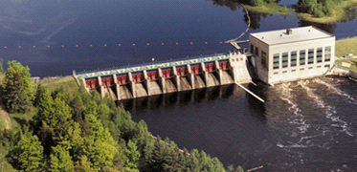
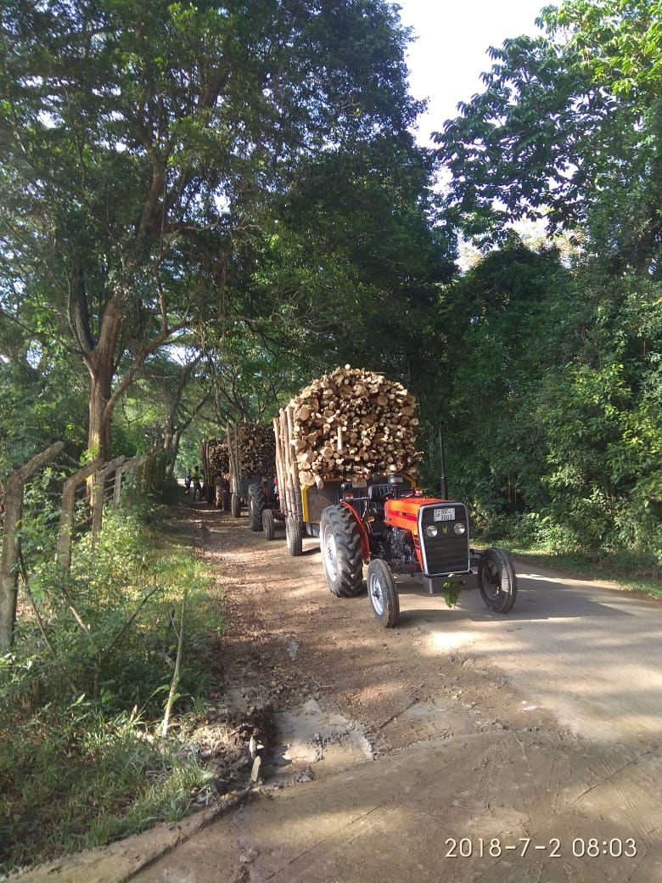
TheSun–
The Source of All Energy Forms-Including Energy for Plant Growth
and it is free
Let us harness this Bounty of nature effectively

Slide 3
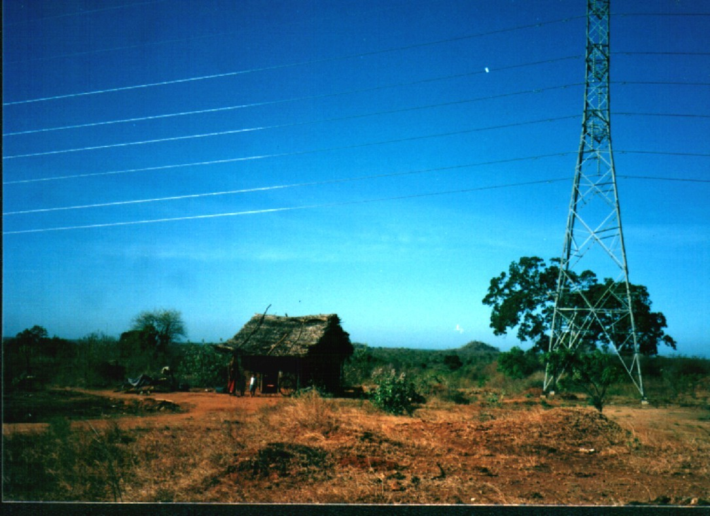
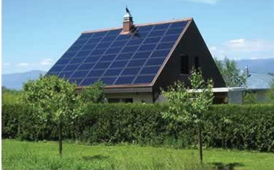
Let him too participate and benefit from the energy economy
Power for the People by the People
Make Energy a Consumer’s business

Slide 4

Mankind’suseoffossilfuel
We too are trapped in the blip
400Years
Beginningof
Civilization
5000Yearshence
5000Yearsago
Now

Slide 5
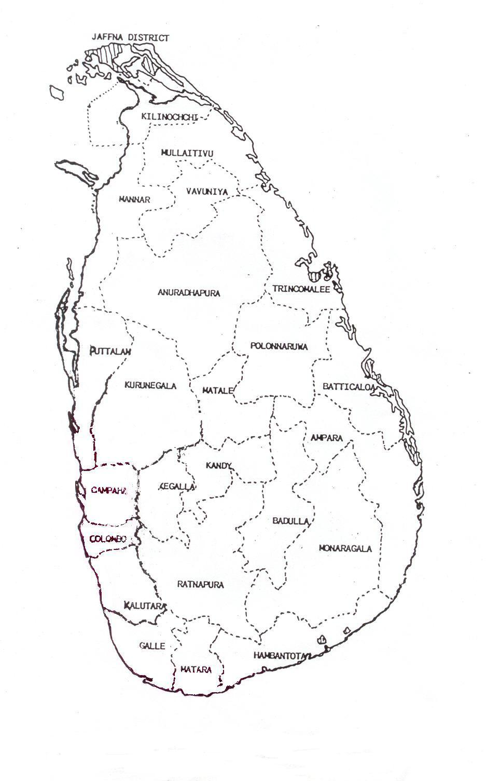
ConvertingtheDraintoa‘Spin’
Cost of Fuel Imports for Electricity and Transport
US$5000 Million and will continue to increase
TheBurden
ConverttoaBoon
Rs.
Rs.
CERS
$$$
CERS
$$$
$$$
Rs.
$
CostofEnergyandotherimports
DrainingtheEconomy
ValueofEnergyandlocalinputs
CatalysingtheEconomy!!

Slide 6
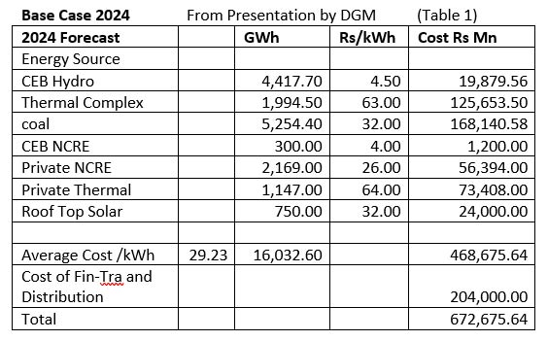
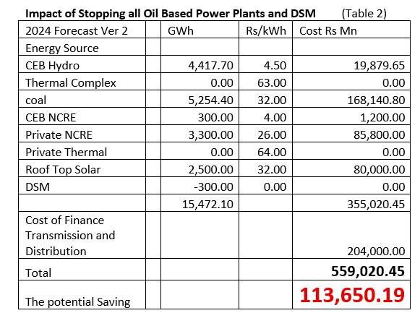
Oil is the Prime Culprit for the damage

Slide 7
What do we need to add ?
1400 GWh of Roof Top Solar PV from 1000 MW addition
3015 GWh NCRE –
  Wind , 1380 GWh from 450 MW addition
  Solar Parks 350 GWH from 250 MW addition
  Bio Mass, 375 GWh from 50 MW addition
  Mini Hydro 275 GWh from 70 MW addition
DSM 300 GWh
  Replace 20 Million CFL bulbs with LEDS
  Replace old motors with Energy Efficient motors

Slide 8
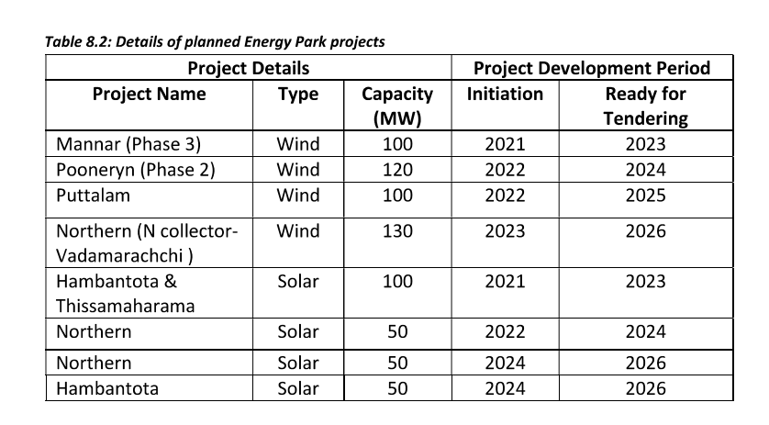
Current Projects in pipe line outside NCRE scope
RE Development Plan 2022 - SLSEA
450 MW
250 MW
The two illegal unsolicited wind and solar projects promoted by the Ministry are ignored

Slide 9
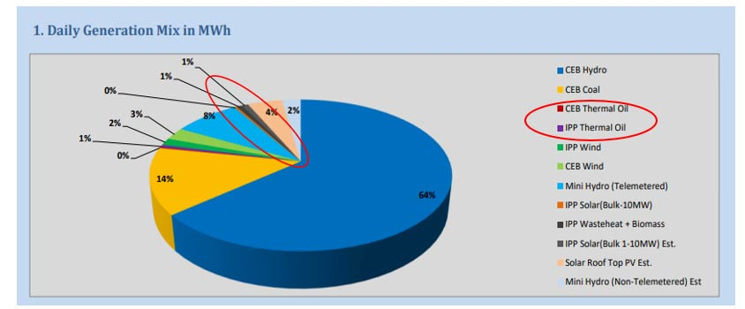
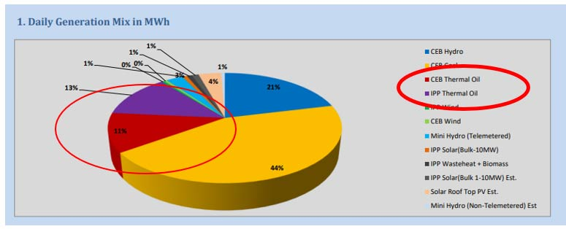
The Change possible is in our hands
TheEnergyMixIn1stJan2024
TheEnergyMixon9thMarch2024

Slide 10
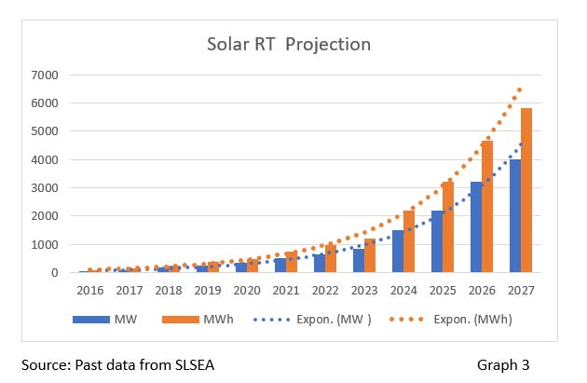
The Path is Clear–RT Solar is leading the race
65,000 Prosumers and Counting
Passed the1000 MW

Slide 11
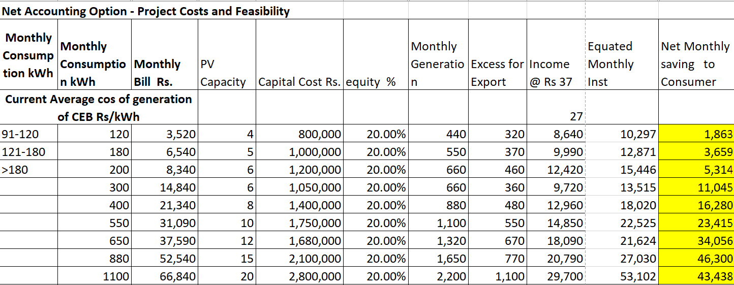
It is the proverbial Win- Win in practice

Slide 12
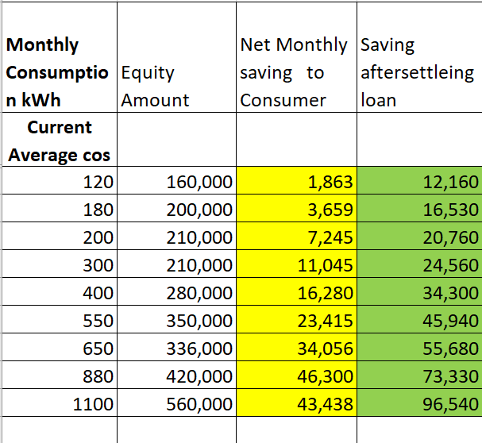
Additional Income to Prosumers !!

Slide 13
The Multiple Benefits to Prosumer and Sri Lanka
Feasible even for low consumption prosumers
Total Insulation from all future tariff increases
Net Income even when paying loan instalments
The best investment in town
Each kWh removes one kWh of oil and helps reduce FOREX drain
The current impact – with 1000 MW of RT Solar PV
  1,320 GWh saving in annual generation
  $ 277 Million saving of FOREX Annually
  Saving to CEB Rs 55 Billion annually - 1320 x(68-26) X 10⁶

Slide 14
A new Dawn for Bio Energy
“Role of Bio Energy for Long Term Energy Security “
Power for the People by the People
make Energy a Consumers business
Eng. Parakrama Jayainghe
Bio Energy Association of Sri Lanka

Slide 15

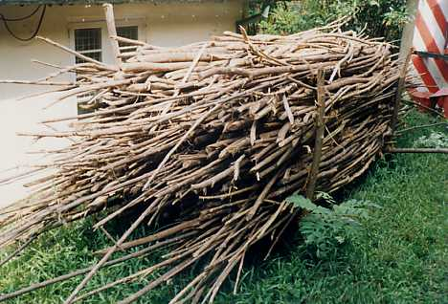

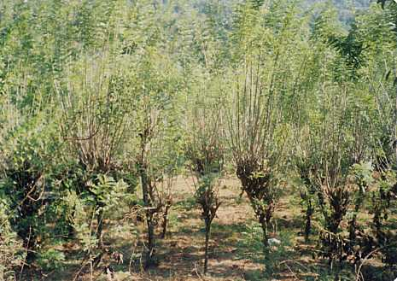
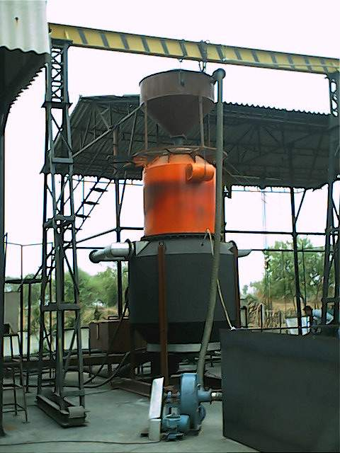
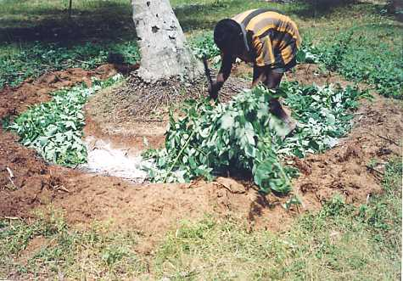
TRANSPORT & RELATED
SERVICES
Rs.
Rs.
EMPLOYMENT
Biomass Economy
Electricity
Rs.
Heat
Fuelwood
MARKETS
Rs.
FODDER
ENERGY PLANTATION
LIVESTOCK
ASH
Milk
MACHINERY
INDUSTRY
Urea Replacement
DUNG
ORGANIC
FERTILIZER
ORGANIC
FERTILIZER

Slide 16
Multiple Benefits of Dendro Power
Firm power with Plant factor exceeding 80%
Entirely indigenous fuel supply
Massive cash inflows to the rural economy @ Rs 80 Million ( $ 200,000) per MW annually
Multiple Social , environmental and economic benefits
Path opened for organic fertilizer and milk production

Slide 17

Some Numbers to Note !!
From even 100 MW of Dendro Power we can get
Rs 8,000 Million ( $ 23 Million )added to the rural economy annually for fuel wood sales
Rs 10 Billion ($ 30 Million ) annualy from 2700 Million litres of milk –
Rs 1.68 Billion from organic fertilizer equt value of 70,000 kg of urea

Slide 18
The potential windfall possible
“According to a study by the Sustainable Energy Authority,
Sri Lanka has a bounty of nature
The On Shore and Off Shore wind Potential – 102,000 MW
The Solar Potential - 106,000 MW
We need only 10,000 MW to meet the domestic needs
Let us target monetizing of only 25% of the excess

Slide 19
The Conventional Wisdom !!
Energy Security
GDP Growth
Energy Demand Growth
Congruent with

Slide 20
A New Paradigm !!
The Energy Sector to be a Sri Lankan Industry
Enhances and supports GDP Growth
Power Generation with indigenous resources
By Sri Lankans
Every Roof Top a Power Plant
Every Garden an Energy Plantation
The Consumer to be a “ Prosumer”

Slide 21
Stage 1 – Year 2030 for internal energy security
Year |  | MW | PF | MWh | GWh |  | Oil Savings @$ 0.21 US$
2030 | Solar | 5000 | 0.16 | 7,008,000 | 7,008 |  | 1,471,680
 | wind | 4000 | 0.35 | 12,264,000 | 12,264 | 19,272 | 2,575,440
 | Bio Mass | 500 | 0.85 | 3,723,000 | 3,723 |  | 781,830
 | Mini Hydro | 500 | 0.45 | 1,971,000 | 1,971 |  | 413,910
 |  | 10000 |  | 24,966,000 | 24,966 |  | 5,242,860

Slide 22
Stage II – Export Potential to tap the Pot of Gold
Export Potential of Renewable Energy
Source | Capacity addition Target by 2030 MW | Plant Factor Average % | Annual Energy Input to Grid GWh | Potential Earning annually @ $ 80 /MWh
Solar PV | 25,000 | 0.16 | 35,040,000 | 2,803,200,000
Wind | 20,000 | 0.35 | 61,320,000 | 4,905,600,000
 |  |  | 96,360,000 | 7,708,800,000

Slide 23
Some essential firm policy decisions are needed for a Secure Energy Future
Energy is Sri Lanka’s own asset and belongs to the citizens
Ensuring future energy security, which is essential for national security, depends on achievement of none dependence on imported fossil fuels and to be a Sri Lankan Industry controlled and governed by Sri Lanka
While any foreign investments are welcome and encouraged to make the transition smooth and on target, they must be compensated under the existing systems of BOI investments and there shall be no tariff paid in foreign exchange when the consumption is for local usage
Electricity industry should be viewed not merely as serving the energy needs of other sectors of the economy , but as a sector which can contribute heavily to the economy and GDP growth with employment generation, high level skills development and technical advancement.
The well recognized bounty of renewable energy many fold over the needs of the country should be developed as a means of earning foreign exchange, which is the segment to invite foreigners to invest in this sector , who can be paid in foreign exchange while ensuring the fair share of the benefits to flow to the national economy as done by the middle eastern countries with their oil reserves.

Slide 24
Is there a Stage 1 A ?
Sri Lanka continues to ignore the Elephant in the Room – The Transport fuels- taking up 75% of imported fuels
The world will stop manufacturing ICE vehicles by 2035
The Current Energy Policy states that 25% of Light vehicles should be EVs by 2023, once more ignored by everyone
But that change can be done by consumers themselves
Out of Current Population of light vehicles ( 2020)
Private Cars 708,000
Three wheelers 988,300
Motor Cycles 2,990,000t

Slide 25
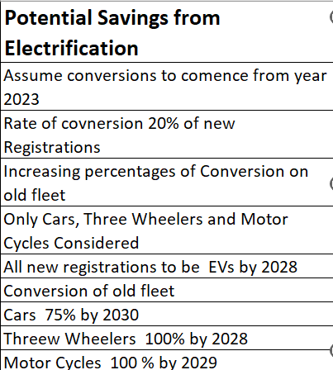
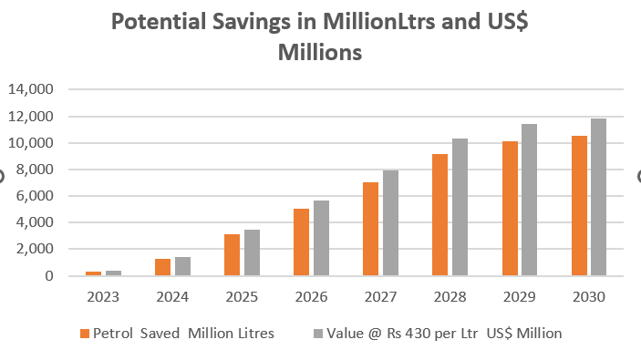
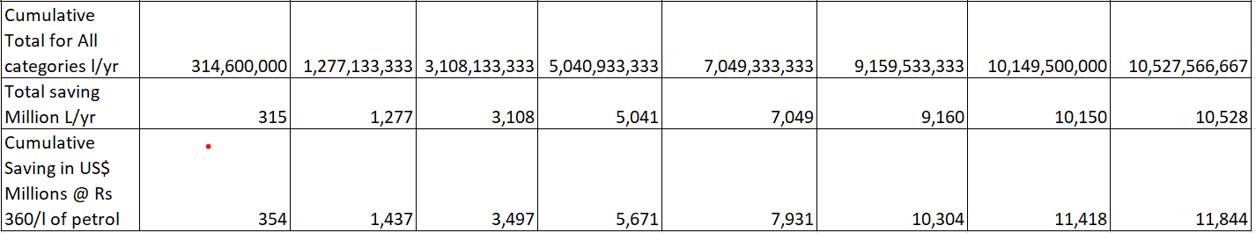
The Elephant in the room !

Slide 26
Converting the Drain to a ‘Spin’ Agressively
Cost of Fuel Imports for Electricity and Transport
US $ 5000 Million and will continue to increase
Export Potential Minimum $ 7.8 Billion Annually
The Burden
Convert to a Boon
$$$
Rs.
Rs.
Energy Exports
CERS
$$$
$$$
Rs.
$
EV Conversion $ 11 Million saved Annually
Cost of Energy and other imports
Draining the Economy
Value of Energy and local inputs
Catalysing the Economy !!

Slide 27
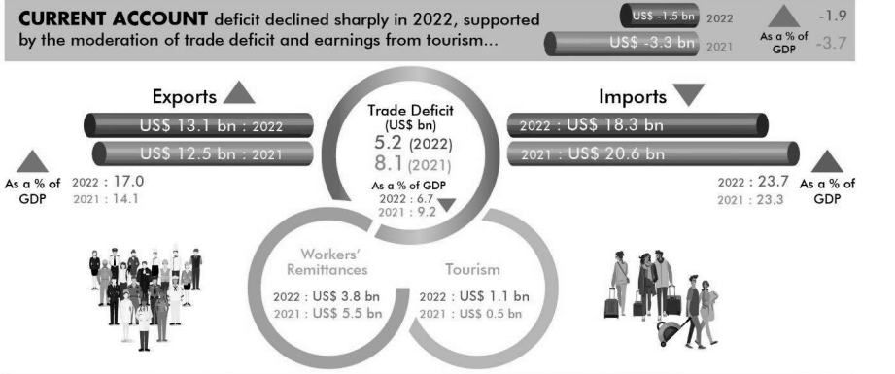
The Comparisons in Context- CBSL Report 2022

Slide 28
Who could make this change?
Sri Lankan Entrepreneurs big and small can do this
The State policies should be aligned to facilitate this
But the Prosumers can provide the initial impetus
The Banking Sector has a major role to play by at least allocating a fair share of their loan portfolio to support the renewable energy sector
Creating the awareness that our national bounty should be to our benefits and not to be grabbed by foreigners

Slide 29
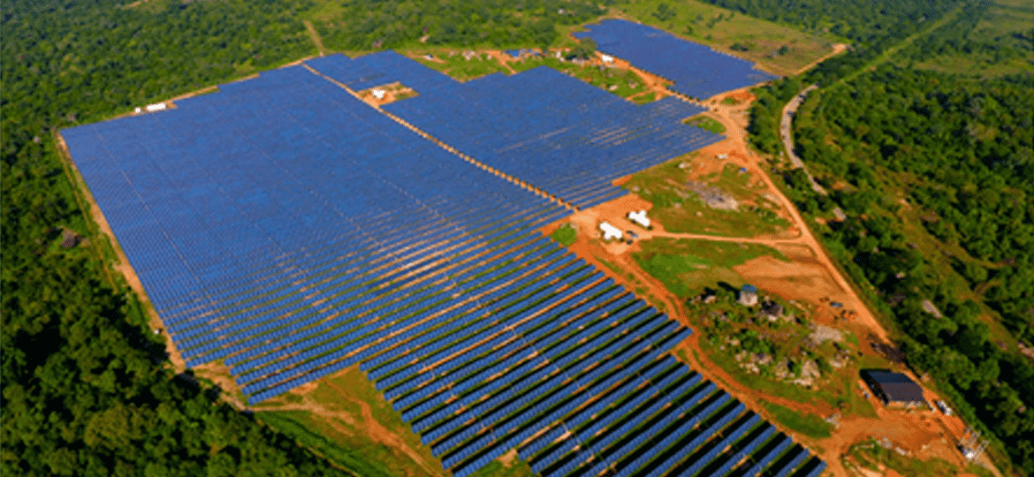
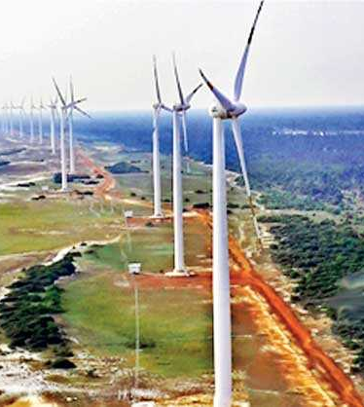
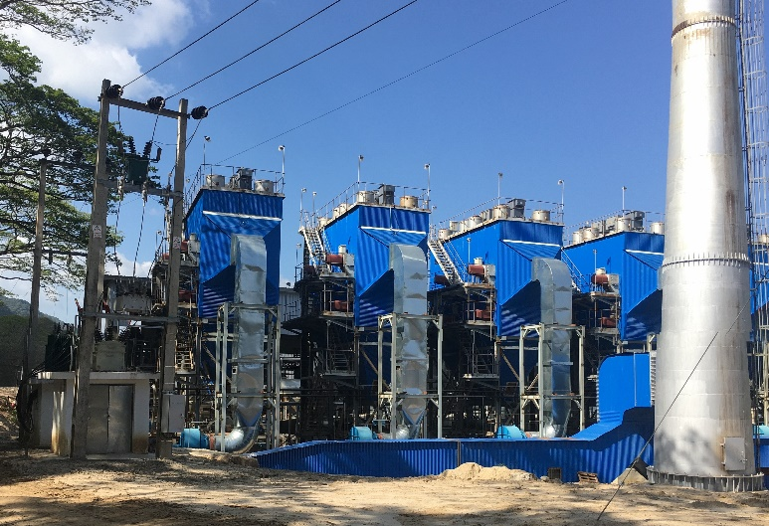
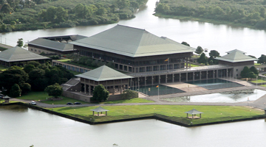
A Collective Responsibility towards an Energy Secure Sri Lanka - Developed by Sri Lankans
Energy Sector Investors & Prosumers
Energy and Power Ministries, PUCSL SEA and CEB CPC ,
Thank You !
The State, Agri and Energy Specialists, Academia
Farmers and Wood Suppliers

Slide 30
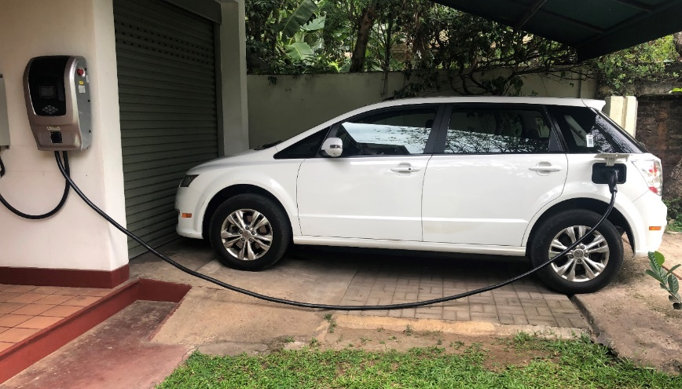
Let him too participate and benefit from the energy economy
Power for the People by the People
make Energy a Consumers business

Slide 31
Sri Lanka is uniquely placed to attain sustainability of energy supply from indigenous renewable resources and an all electric future is not a dream
Thank You !

